Slide 1

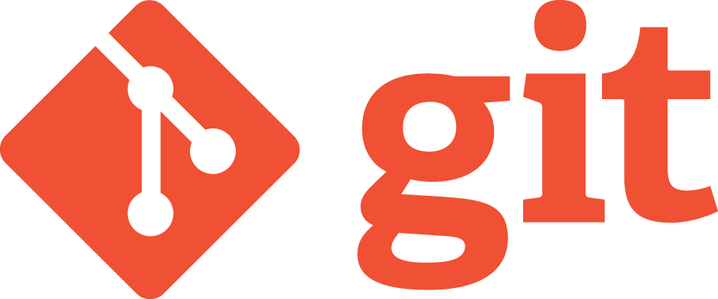

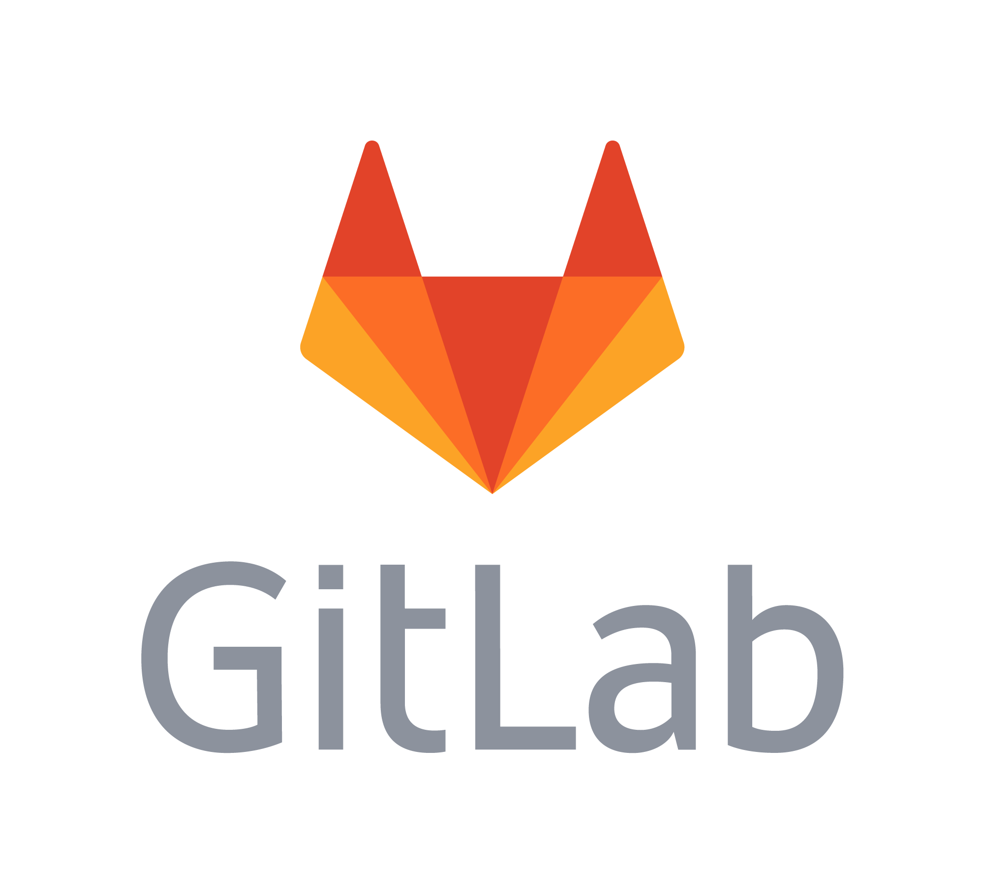

1 – FOSS Communities and Collaboration
Images from:
https://www.atlassian.com/company/news/press-kit
https://about.gitlab.com/press/press-kit/
https://git-scm.com/downloads/logos
https://github.com/logos

Slide 2
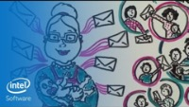
Open Source Basics
https://www.youtube.com/watch?v=Tyd0FO0tko8 (5:41)
by Sarah Moyle for Intel Software
Notes:
Sarah Moyle – Visual Story Teller
“Introduced innovative facilitation methods inside Intel”
Good metaphor for the processes that FOSS communities use to collaborate,
Give us a big picture to carry around in our minds as we work through some of the details over the next three weeks.
Have them note vocabulary terms as it plays.
- Collect a list on the board
- Have light discussion or clarification of the terms.
Some Key Ones:
- Rules and Roles and Common Language
- Rules -> License
- Roles: Contributor, Maintainer
- Common language:
- Upstreaming
- Also add Upstream (though not in video)
- Branch / Patch
- Main branch
- Fork
“Upstream early and often”
- What does that mean?
- Why do it?

Slide 3
FOSS is Produced by Communities
An open source software community is a group of people united by the shared purpose of developing, maintaining, extending, and promoting a specific body of open source software. These communities are often globally distributed—their members occupy different geographic regions and work across numerous industries. What unites them is their common vision for the open source software project—as well as the spirit of camaraderie and collective identity that participating in the community affords them.
https://www.theopensourceway.org/ the_open_source_way-guidebook2.0.html
Notes:
Discuss in small groups:
ASK: Who makes up the community in the Cookie example?
ASK: What are some challenges that an open source community will face?
- Coordination and Collaboration
- globally distributed
- different regions / languages / time zones
- different industries
ASK: What advantages/opportunities does an open source community afford?
- larger community
- more diverse community
- varied perspectives
- distinct skill sets and expertise

Slide 4
Principles of FOSS Communities
Shared Values
Collaboration
Transparency
Inclusivity
Meritocracy
Release Early & Often
List adapted from: https://opensource.com/open-source-way
Notes:
https://opensource.com/open-source-way
Opensource.com
- “Opensource.com is a premier, daily publication focused on open source and Linux tutorials, stories, and resources.”
- “This site is one of the ways in which Red Hat gives something back to the open source community.”
- RedHat – one of the top open source organizations in the world.
- For context, purchased by IBM for $34B
- “In 2020, Opensource.com is read by 2 million people across the globe.”
Discuss in small groups.
- Ask: These words should be somewhat intuitive.
- What do you think they mean in the context of a FOSS community?
- That is what does it mean for a FOSS community to have shared values? Or be inclusive?
- Ask: Why are these good things?
- That is what advantages do they confer in FOSS communities?

Slide 5
Roles in FOSS Communities
Users
Leaders
Contributors
Maintainers
Requesters
Notes:
The video identified the roles of:
- Contributor and Maintainer
Larger communities may have a greater diversity of roles.
Discuss in small groups:
- ASK: Think about these roles and what they might do in a project.
- ASK: Then order them from:
a. Most to least project knowledge
b. Most to least responsibility
c. Most to least trusted
d. Smallest to largest group
Compare the ordering and ask what discussions took place.
Use as a chance to distinguish between:
- contributor vs requestor
- leader vs maintainer
As a class:
ASK some of the following as appropriate:
- In the cookie metaphor:
- What role did Aunt May have? (Leader / Maintainer?)
- What role did Aunt Maria have when she added chocolate chips? (Contributor)
- What about Uncle Miles when he added nuts? (also Contributor)
- What would it mean to be a user?
- Bake or eat cookies.
- What would it mean to be a requestor?
- Ask Aunt May to put coconut in the cookies but don’t modify the recipe yourself.
ASK: Which roles would likely have direct write permissions to the upstream project?
- Leaders / Maintainers
ASK: When you first want to add new code to a project what role would you likely have?
- Contributor
Notes:
Users: download and use the software.
Requesters: report defects and ask for new features
Contributors: add features, fix bugs, etc by upstreaming.
Maintainers: core project members with specific responsibilities and write permissions to the main branch
Leaders: make key decisions and consider long-term project goals.

Slide 6
Version Control Systems
Version control systems are software tools for:
Maintaining project history
Review
Revert
Facilitating collaboration
main branch / production version
Developers working asynchronously on feature branches
Merging new features into main branch
Notes:
FOSS and more generally all large software projects developed by teams can be complicated to manage.
Some of the things said in the Cookie Video emphasize this:
- “How the potential chaos of all these copies can be transformed into a collaborative whole.”
- “Has potential to be complicated because it is created by communities of people”
- “These ways of working manage those communities making it possible to benefit from new versions from an authoritative source”
- At the end she states that this all “Requires a disciplined way of managing change”
- Need good tool support
- VC is one part of that support.

Slide 7
git and GitHub
Tools for version control and collaboration:
git
CLI version control tool that runs on your computer
maintains repositories (repos)
complete copy of the code / docs
complete history of changes
gitHub
a cloud service for hosting repositories
facilitates collaboration
Forking/Upstreaming support
Issue tracker
Notes:
Git and GitHub are currently the dominant tools for supporting version control and collaboration in software development.
These two tools work together.
Very broadly:
- Individual developers use git
- to manage their repositories and track code changes.
- Communities use GitHub
- to bring together changes from developers
- to track and communicate needs (e.g. issue tracker)

Slide 8




Other Options
Version control tools:
CVS, Subversion (SVN), Mercurial
Repository Hosting:
GitLab, BitBucket, SourceForge
Images from: https://www.linuxnix.com/what-are-the-top-version-control-systems/
https://sourceforge.net/p/gmorgan/admin/files/badges
Notes:
Git and GitHub may be dominant now, but lots of other options exist and are being used.
These are just some examples to indicate that there is breadth here.
You may encounter different tools in different projects, communities or companies.
Most will rely on the same set of fundamental concepts.
- While we are learning Git / GitHub specifically
- We will do so in a way that focuses on the larger concepts
- That will hopefully make what you learn more flexible and generalizable

Slide 9
GitHub and git: Local vs Remote
Notes:
Note: If edits or modifications are needed the source images for these slides are in 07-GitHub-OLD-copy.pptx.
Local are things that are on your machine
- saved on your hard disk
- can be used without access to a network
- you will interact with them using your tools
- editor
- browser
- shell
- git
- etc
Remote are things that are in the cloud
- Stored on servers in data centers somewhere out on the internet
- E.g. at GitHub or GitLab, etc…
- You will interact with them through your browser.

Slide 10
GitHub and git: The Upstream
The
Upstream
Repository
Notes:
When you go to join a FOSS community and use or contribute to its project:
- The project code will typically live on one of the repository hosting services.
- This is the upstream repository
- It is Aunt May’s cookie recipe.
ASK: Why does it live on a hosting service?
- Collaboration, transparency, release early & often
ASK: Will you have write permissions to the upstream?
- Nope, at least not until you gain trust and move up to a maintainer role.

Slide 11
GitHub and git: Forking the Upstream
Notes:
The first step in working with the project is to Fork the Upstream.
- I.e. to make your own copy of the main project repo.
ASK: Why would you need to make a copy?
- To make changes you need write permissions.
- You have full control over this copy.
- Add chocolate chips, add nuts, add coconut, you name it.
ASK: How many forks will there be?
- At least as many as there are developers
This fork:
- is exactly like the upstream (main project) repository
- remembers the upstream from which it was forked (dotted orange arrow)
- We will see that this makes it possible to upstream the changes.
Note: The slightly different meaning of fork here than in the video.
- The video was talking about forking or splitting the community
- I.e. Uncle Miles and his nut lovers go one way, Aunt May goes the other.
- You need a copy to do that too.
- Here the fork is just a copy of the repository.
- It could be used to fork the community
- But can also be used to upstream changes.

Slide 12
GitHub and git: Cloning your Origin
Your
Origin
Repository
Your
Local
Repository
Notes:
The next step is to Clone your fork.
- I.e. make another copy of the repository on your local machine.
- That copy is your Local repository.
- It is on your local machine (i.e. in Linux Lite in this class).
- This fork from which your local repo is cloned is called your origin repository.
ASK: Why do this?
- Can open files with your editor
- Can compile and run the code
- Can work without network access (crazy!)
Note that the local clone knows its origin
- i.e. where it came from.
ASK: Why should it know that?
- It is how we will be able to upstream changes!
Note: Things seem to be moving toward being able to do most if not all of that in the cloud
- from within your browser
- running tools and code on a server somewhere else.
- but not quite completely there yet.
- also likely will cost $$ to operate that way.

Slide 13
GitHub and git: Cloning your Origin
Your
Origin (Fork)
Repository
Your
Local (Clone)
Repository
Notes:
The next step is to Clone your fork.
- I.e. make another copy of the repository on your local machine.
- That copy is your Local repository.
- It is on your local machine (i.e. in Linux Lite in this class).
- This fork from which your local repo is cloned is called your origin repository.
ASK: Why do this?
- Can open files with your editor
- Can compile and run the code
- Can work without network access (crazy!)
Note that the local clone knows its origin
- i.e. where it came from.
ASK: Why should it know that?
- It is how we will be able to upstream changes!
Note: Things seem to be moving toward being able to do most if not all of that in the cloud
- from within your browser
- running tools and code on a server somewhere else.
- but not quite completely there yet.
- also likely will cost $$ to operate that way.

Slide 14
GitHub and git: Ready to work
Notes:
The state of things when you are ready to work on the project.
You will identify something to do:
- something that you want
- Add chocolate chips or nuts or coconut, go crazy!
- You can do anything you want, its your copy and its FOSS licensed.
- something that the community wants to have done

Slide 15
GitHub and git: Make Changes*
Simplified
for now
Notes:
Changing the words to green is a simple representation of some changes to the code.
I say this is simplified.
ASK: What do you think might be simplified and why?
- The code is in a version controlled repository
- So making changes isn’t quite as simple as opening the file, editing, saving.
- Recall that version control maintains a complete history of all changes.
- So ensuring that that history is maintained is one of the things we’ll have to deal with.

Slide 16
GitHub and git: Push to Origin
Notes:
Now that you have changes that you like…
Maybe you want to upstream them.
To do that you’ll need to get them to cloud
- To your remote repo – your origin
- and eventually to the main repo – the upstream.
The first step is to push the changes to your origin.
- The change to green in the origin reflects your local changes being copied there.
ASK: What makes it necessary to push changes to origin?
- The upstream repo cannot see your local copy
- You cannot write to the upstream repo.
- So pushing puts your changes into the hosting service
- So that eventually the upstream can see them.

Slide 17
GitHub and git: Making a Pull Request
Notes:
Now your changes are in the hosting service
- the upstream repo can see them
- you need to tell the project maintainers that you have something you want to upstream.
- You do that by making a Pull request.
- The pull request sends a message to the upstream
- tells them that you have changes in your origin
- and you would like those merged into the main project.
- Aunt Maria wants to add chocolate chips.
- Uncle Miles wants to add nuts.

Slide 18
GitHub and git: Merge into Upstream
Notes:
If the project maintainers/leaders like your proposed changes
- they are merged into the upstream.
- I.e. your code is combined with the code in the main repo
- i.e. it becomes part of the main program.
- I.e. Aunt May’s recipe now contains chocolate chips.

Slide 19
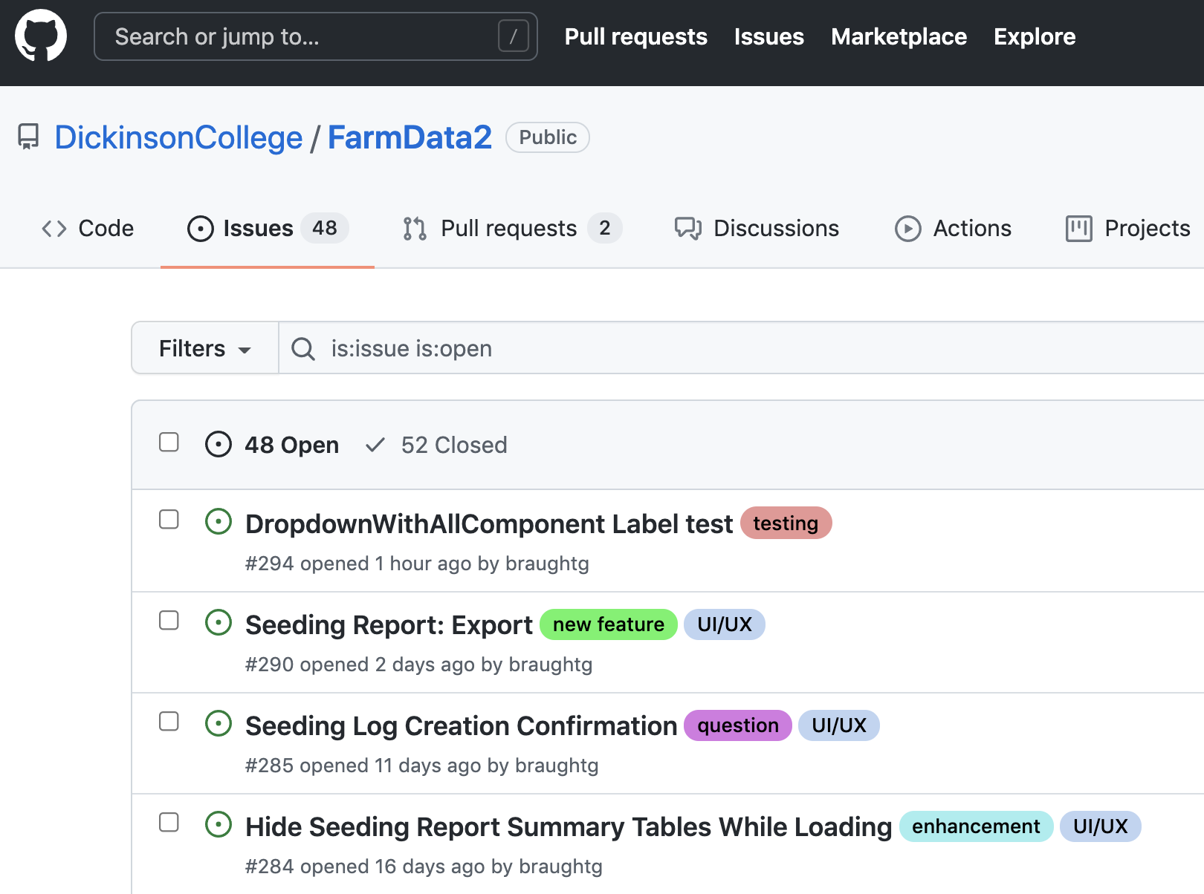
The Issue Tracker
Notes:
The issue tracker contains a list of things that need to be done in the project
- new features to be added
- bugs to be fixed
- features to be enhanced
- testing to be done
- questions to be answered
- etc…
You will get interact with an issue tracker in the Activity

Slide 20

Acknowledgments:
Slide Template From:
https://creativecommons.org/licenses/by/4.0/
Slide Content Licensed as:
https://creativecommons.org/licenses/by-nc/4.0/

